Slide 1
The 2024 Girl Scout Cookie Program
Notes:
Hi Everyone! Welcome to our troop’s 2024 Cookie Kickoff!!

Slide 2
Agenda
5 Skills
Dates & Themes
Cookies
How to Sell
Safety
What You Earn
Notes:
It’s cookie season! Who’s excited!?! Me too! So tonight we’re going to learn how to be Cookie Experts, set some goals for our program, and learn about some of the things we can earn from our sales.
We’re going to listen to Lottie the Axolotl tell us about the cookie program first! Show the Troop Kickoff Video (found on The Bridge)

Slide 3
Five Skills
Goal Setting – “I know I can do it!”
Decision Making – “How are we going to reach our goals?”
Money Management – “Putting earnings to good use”
People Skills – “How to take no for an answer”
Business Ethics – “Leave a lasting impression”
Notes:
Does anyone know how long the cookie program has been around? (insert guesses)
Over 100 years! And one of the reasons it’s been so popular is because not only are the cookies so delicious, but Girl Scouts actually learn a lot of valuable skills during the program.
Here are the some of the things we’ll learn during the Cookie Program. Can you think of any other jobs where these skills might be important?

Slide 4
Dates and Theme
February 1
– March 24
Feb. 1 –
March 24
Notes:
Does anyone remember when Lottie said the Cookie Program starts? [Click for answer]
February 1! That means we can’t start selling cookies until then, but there’s lots of ways you can start to get ready!!
Now… before we go any further I want you to raise your right hand and repeat after me: (we like doing a repeat-after-me on occasion when they need to remember something important, for some reason they always get a kick out of it and think it’s funny but they remember! We always try to make it a little bit silly).
“My name is _______ and I'm a Girl Scout… I like camping, badges and lots of chocolate… On my honor I will not take cookie orders until February 1… Not tonight… not tomorrow…. If Aunt Sally Jo wants to order cookies on January 27th I will tell her she has to wait… because Business Ethics are important… and I don’t want Ms. [Insert Your Name] to be disappointed… On February 1 I can sell 4 million boxes if I so choose…" Ok moving on, you can put your hands down. This is important because Girl Scouts all around Iowa are getting the same rules and it’s the right thing to do and important that we all start at the same time to be honest and fair.

Slide 5
Lottie the Axolotl
Find additional graphics on flickr
Notes:
Each year a national cookie mascot is chosen and this year’s mascot, the Axolotl is as cute as can be! You’ll find Lottie the Axolotl represented in materials and rewards across the program! Girls and troops can learn more about Lottie the Axolotl and the cookie program at our cookie kickoff event!

Slide 6
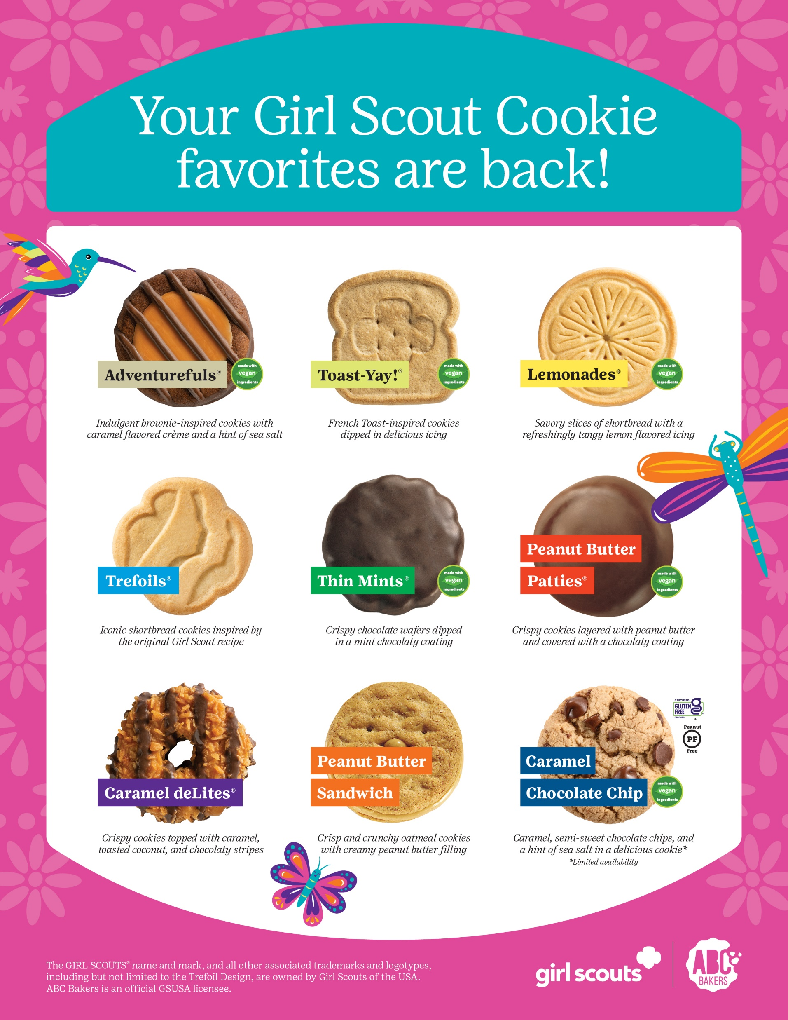
Notes:
First off, let’s talk about one of most important parts of the Cookie Program – the cookies!
Girl Scouts of Greater Iowa partners with ABC Bakers, who has provided cookies for GSGI for over 15 years! They are one of two bakers nationwide who supply cookies to the Girl Scouts, and you can see the nine varieties that ABC makes, and we can sell in-person or online, and all are $6 this year.
Thin Mints continue to be the number one cookie sold!
In addition to having a baking facility right here in Iowa, part of what makes ABC a great choice for Greater Iowa are the “ABC Bakers Choice Cookies”
These are Lemonades and Toast-YAY!
Also, speaking of cookies, the Caramel Chocolate Chip Cookie is back again this year! It is a great Gluten Free Option!

Slide 7
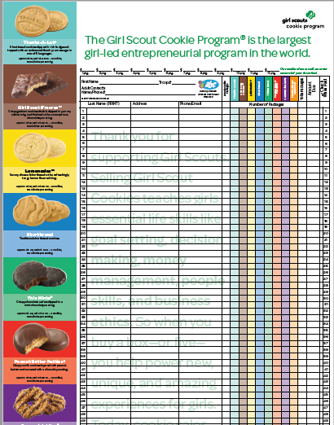
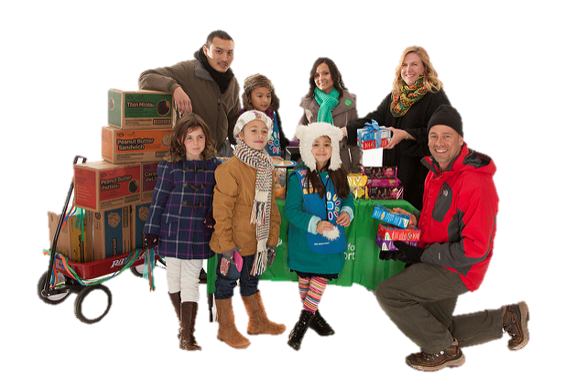
How to Sell
Order Taking
Booth Sales
Online
Notes:
Does anyone remember the different ways you can sell cookies? You can take orders in-person using your Order Card or an online store, starting February 1! The benefit of an online store is that your customers can pay with a credit card and you can drop them off later! You can also sell with our troop at booth sales, create your own “Lemonade stand” or of course, sell online or to friends and neighbors in person!

Slide 8
Safety
How do you think you can stay safe selling cookies?
Always sell with a buddy or adult
Don’t go up to houses with no lights on
Don’t go inside strangers' homes
Follow traffic rules when crossing streets
Be sure to use the internet with an adult
Notes:
SAFETY!! It’s the most important thing. Yes, we want to sell a lot of cookies, but it’s important that you work with a trusted adult. Selling to friends and neighbors is a great idea, but keep in mind a few things. A simple acronym is SWAT.
Strangers: Be cautious with people you don’t know. Don’t enter the homes of people you don’t know. Don’t provide your school or last name. (do quick role play with 2 girls here). Weather: Dress for the weather. Whether rainy, icy or snowy, it’s important to protect yourself. (coat, hat, gloves, boots, or not going out if weather creates poor road conditions)
Adult: It’s important that an adult be part of your cookie program. Whether selling door to door, a booth or online, they should be guiding the steps you take.
Traffic: If you are selling door to door, make sure to follow all traffic guidelines and watch out for cars. The most dangerous time of day is at dusk, because when the sun is starting to set it's harder to see! Wear reflective clothing and assume cars do not see you. Never ever expect cars to stop, you have to be the one who is on high alert.

Slide 9
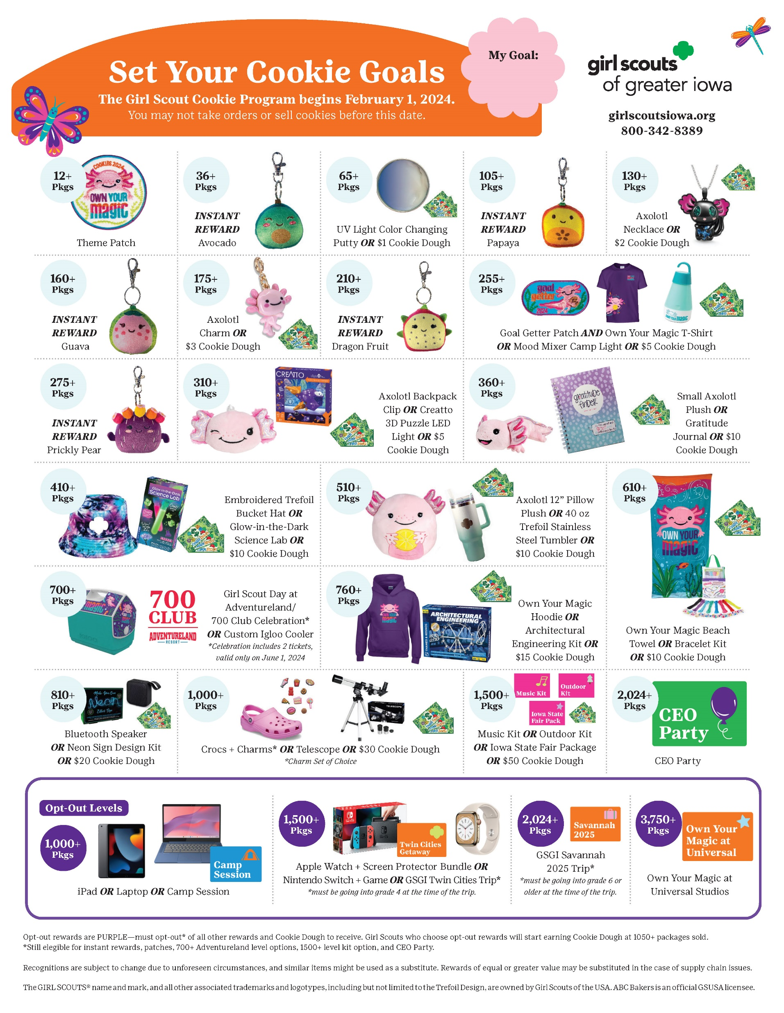
What You Earn!
Base Cookie Dough PLUS optional additional Cookie Dough at most levels
Troop and individual experiences!
Rewards and incentives, as well as the Tropical Fruit Instant Rewards!
Lots of patches!!
New this year! Girls who sell 3,750+ packages can earn a trip to Universal Studios!
Notes:
Drumroll, please!!! You can now see the entire rewards’ lineup for this Cookie season. There are patches and fun items you can earn! They are marked on the back of your cookie order form to remind you what you can earn. Use it to help create your goals. You each get your own copy of the rewards lineup to take with you! Don’t forget – you earn all the levels up to your highest one, PLUS the Cookie Dough that’s listed on the back page.

Slide 10
Instant Rewards
Notes:
Lottie is not alone this Cookie Season. Meet the Tropical Treats – foods that are also found in Mexico, where Lottie lives!
You can earn these rewards INSTANTLY as part of this year’s cookie rewards!
You can earn your first reward for selling 36 packages (that’s only three cases of cookies!)

Slide 11
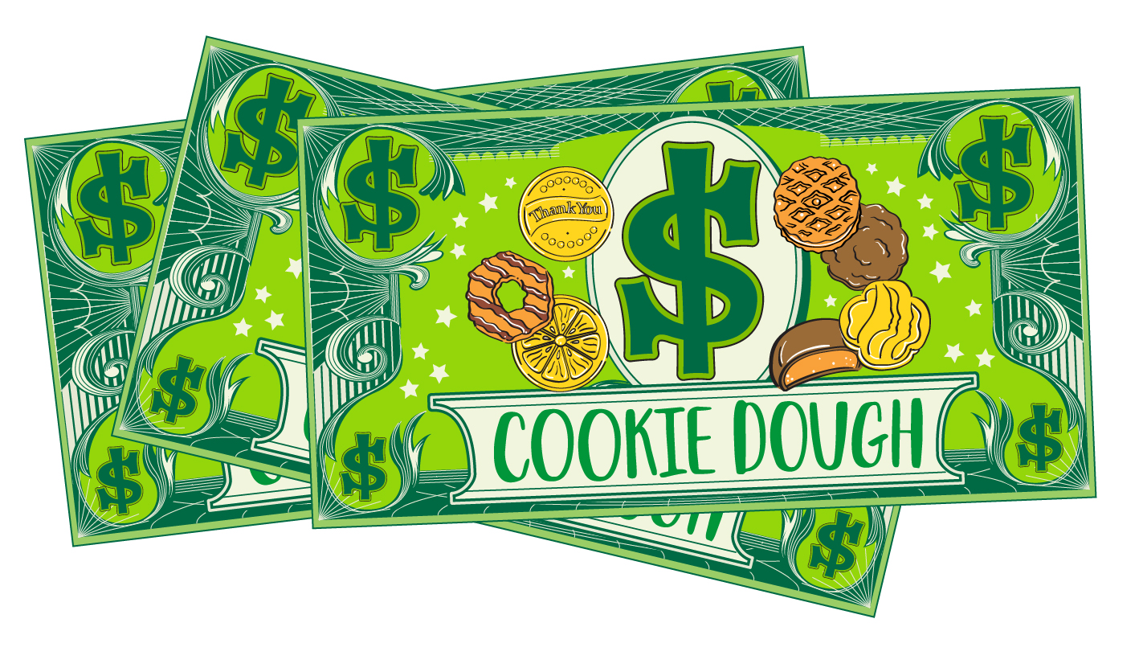
Cookie Dough
Credits you can use like money!
Go to events, camp or shop in the Girl Scout store (in person or online!)
Choose more “dough” instead of items!
Notes:
You start earning Cookie Dough once you sell at least 24 packages! You can use Cookie Dough to go to camp for free, or even go shopping in the Girl Scout Store.

Slide 12
Our Troop’s Goals
Insert your goals here!
Notes:
Enter your troop’s personalized goals here before your kickoff meeting

Slide 13
Troop Proceeds
Troop Proceeds start at $0.85 per package
The more we sell, the more we earn!
New Troops: $0.85 and up to $0.92
Returning Troops: $0.85 and up to $0.95
Cadette, Senior, Ambassador, and Multi-level Troops who opt-off of rewards can earn $0.12 more per package.
Notes:
In addition to rewards, skills and experiences, we know a big incentive for participating in the Cookie Program is the proceeds troops earn to fund activities.
When we talk about troop proceeds, it's a reward we see instantly for our troop, at the end of the program.
We start by earning $0.85 for every package we sell!
Additional Proceed Information, use if you want-
If our troop averages 185 packages sold per girl selling, that increases by 5 cents for a total of $0.90.
If you have an average of 250 packages per girl, you get an additional 2 cents for a total of $0.92.
Returning troops have the ability to earn even more! For each percent that their sales increase year over year (up to 3%) they get a penny more per package: 1, 2, or 3 cents. Which means you can earn up to .75 per package if your troop has a 250+ PGA and increases their sales over last year.
Also, Cadette, Senior, Ambassador, AND Multi-level troops can opt out of the individual reward items for $0.12 more per package. **This does need to be a troop decision**

Slide 14
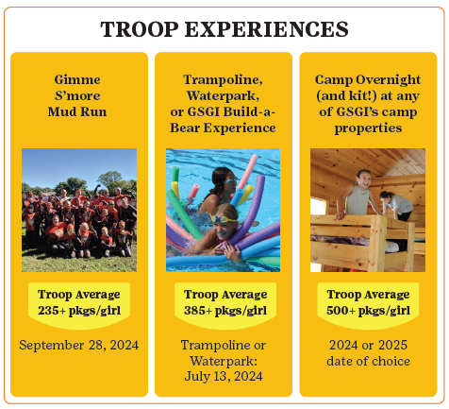
Troop Experiences
Notes:
We also have the opportunity to earn special experiences such as free admission to the Gimme S’more Mud Run OR choice of a trampoline or water park day OR a GSGI Build-A-Bear Experience. New this year! Our troop can earn a free night at camp with a PGA of 500+.

Slide 15
Online and order-taking starts February 1, 2024!
Notes:
Thank you so much! Now we’re going to have you do an activity while we cover a few more details with your parents/guardians.

